Slide 1


Components of the GUSTO Cleanroom
Student: Alyssa Baller
Mentor: Tisha Saltzman
Supervisor: David Dolana

Slide 2
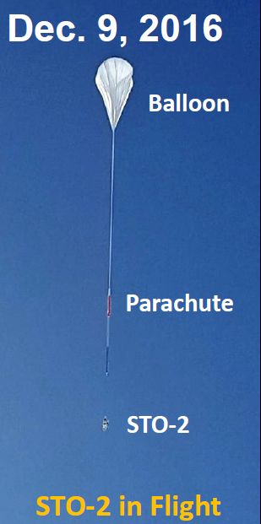
About GUSTO
Galactic/Extragalactic ULDB (Ultra-Long Duration Balloon) Spectroscopic Terahertz Observatory
“Untangling the Complexities of the Interstellar Medium”
The Program has 5 Science Goals:
  Determine the constituents and life cycle of interstellar gas in the Milky Way.
  Witness the formation and destruction of star forming clouds.
  Understand the dynamics and gas flow into and within the Galactic Center.
  Understand the interplay between star formation, stellar winds and radiation, and the structure of the ISM in the LMC.
  Construct Milky Way and LMC templates for comparison to distant galaxies.
Flight Facts:
Flight Duration: 100 days
Launch Date: December 2021
Float Altitude: 33.25 km (~20.7 miles)

Slide 3
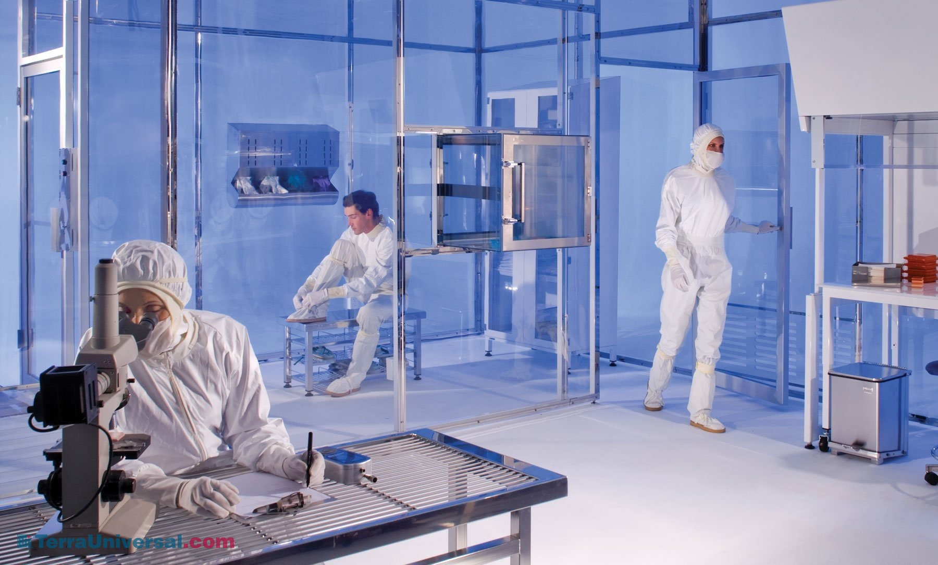
Cleanroom Purpose
A cleanroom is a room in which the number of particles in and being introduced is minimized and components of the room such as temperature, humidity and Electrostatic Discharge (ESD) are closely controlled.
University of Arizona is responsible for the telescope, cryostat, detector, spectrometer, instrument control, data processing, and instrument thermal management which will be in the cleanroom.
The GUSTO cleanroom classification is ISO 7/Class 10,000.
https://www.terrauniversal.com/cleanrooms.php

Slide 4
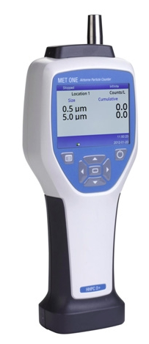
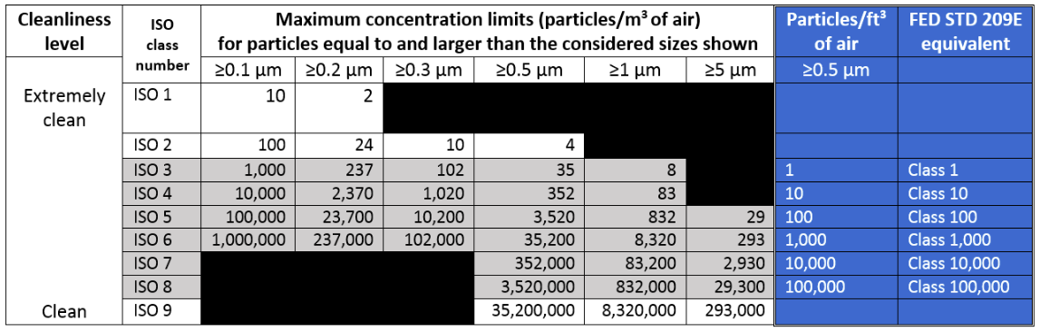
Particle Counts
Cleanroom is ISO 7 classification (Class 10,000)
Data taken at particle sizes of 0.5, 1 and 5 microns
Precautions are taken to limit particles in air such as:
  Cleanroom vacuums are used to clean
  HEPA filters are installed
  Kim wipes and poly cellulose wipes are used within cleanroom
Even with precautions, particle numbers in air will sometimes be above maximum concentration limits and this is not unusual.
MegaDepot: https://megadepot.com/product/beckman-coulter-2089310-03-hhpc-2-handheld-particle-counter-2-channel-5um?format=v&p=ms&source=ads&gclid=CjwKCAiA44LzBRB-EiwA-jJipJQFCQJpy2bQEDgTKgMW4RhmXkrBhGzNKUrHG5z6kRprN4sbW9EYcRoCrbMQAvD_BwE
Mecart Cleanrooms: Cleanroom Classifications. https://www.mecart-cleanrooms.com/learning-center/cleanroom-classifications-iso-8-iso-7-iso-6-iso-5/

Slide 5
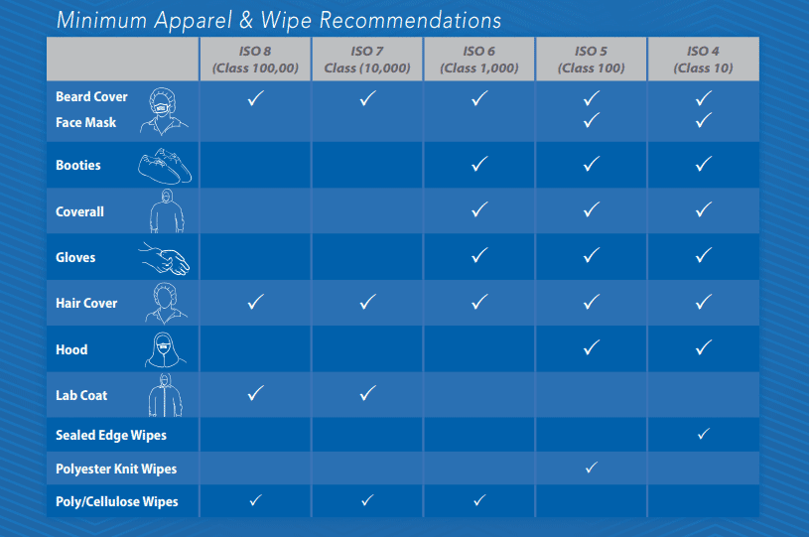
Cleanroom Apparel
https://bluethundertechnologies.com/cleanroom-clothing-requirements-and-selection-guide/

Slide 6
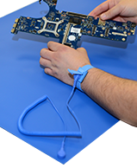
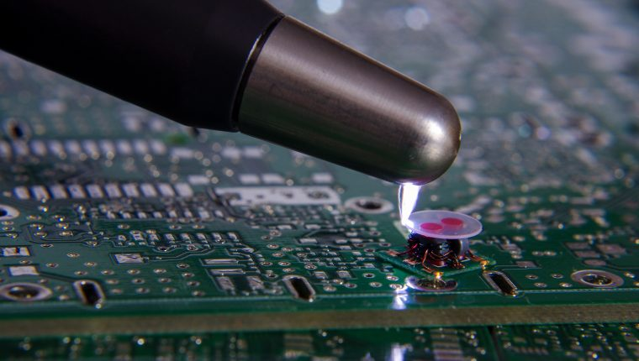
Electrostatic Discharge (ESD)
Electrical “shock” or sudden flow of electricity between two charged objects.
Similar to rubbing your socks on the carpet, then touching someone (about 30,000 volts).
It takes electronics about 30 volts to be damage hardware on our payload.
ESD bracelets are worn to dissipate any built-up charge.
Lower humidity can cause more chance for an ESD event to occur.
  Humidity range needs to be within 30-70%
Dycem: https://www.dycemcc.co.uk/2019/07/electrostatic-discharge-protection/
https://www.antistat.co.uk/product-category/esd-mats/

Slide 7
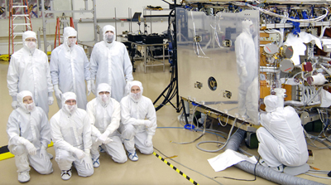
Overall
Cleanrooms
Particle Counts
Gowning
ESD
https://www.nasa.gov/vision/universe/starsgalaxies/gamma_cleanroom.html

Slide 8
Thank You

